Slide 1
LOGIN USING FACE RECOGNITION

Slide 2
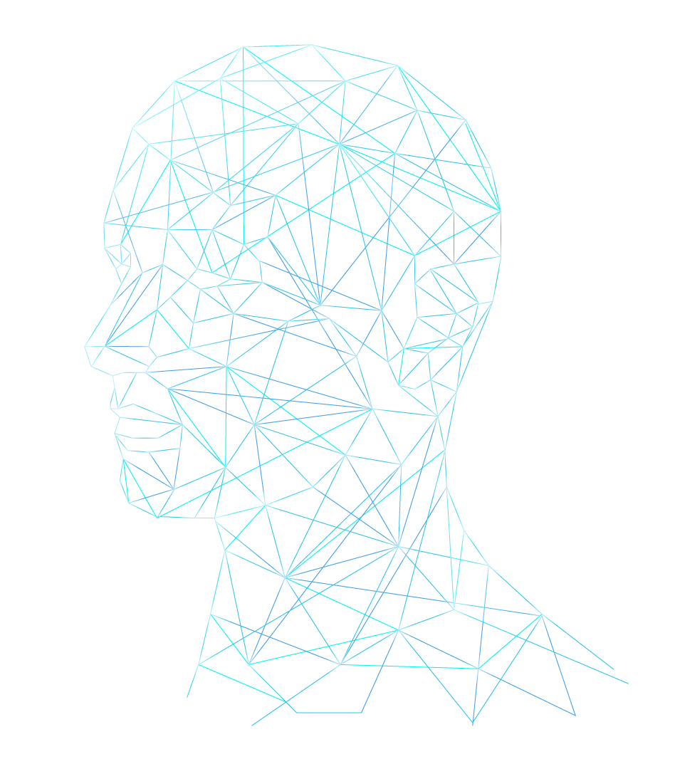
SUBMITTED BY:
ANAND S - 21501783
BALAJAGADEESH M - 21501786
JAGAN S - 21501797
RITHIK S - 21501816
THARUN SIBI V - 21501832
ANGESHKUMAR P - 21590761
GUIDE : Mr. P.GOWTHAM B.E.,

Slide 3
ABSTRACT
Project we implement face login in the entire website that we use.
We decided to create the application using the PHP as the core language for the project and for face deduction we select java script.
The facial data is captured by the web camera and it will be stored in java script file.
While the login match the facial data that are stored as .js file will be
matched with the real time camera capture.
If the data matched login will process. If it fails warning will be
displayed.
We decided to create a module for face register in the
application itself.

Slide 4
ABSTRACT
The multiple users we store the face data in mysql database and match as per the user by the username that we provide on that portal.
For effective face analysis the face data that captured by the camera is converted into a numerical value that mark a graff on the face image that captured.
After the value conversion the numerical identification point are stored.
For 100% successful login we take multiple samples on the registration
process.
This method will ease the login process and there will be no fake logins
and bot logins, and if anyone knows the id they can’t login without
the facial data.

Slide 5
EXISTING SYSTEM
Try to Login a Website from the host address.
Most Website host servicing (e.g., WordPress , Weebly, GoDaddy etc.).
For Login a Website using a Username and Password.

Slide 6
DRAWBACKS
Need to enter user id and the password.
If anyone find/know the user id and the password they can login.
Easily hackable with password snooping.
Easily hackable with keyloggers.
No additional security .

Slide 7
PROPOSED SYSTEM
The proposed system work with facial data of an user.
User need to enter user id and the facial data with the web camera.
User can update the face data after login.
Facial data is captured during Realtime using a web camera of the device.

Slide 8
ADVANTAGES OF PROPOSED SYSTEM
Can’t snoop the facial data.
Facial data is processed on the server side.
For matching Deep Learning algorithms are used.
This algorithm matches the face data and process the data at the server side so hacking is not possible.
for hosting we use flask server and flask session this maintain the site session more efficient comparing to traditional session.

Slide 9
HARDWARE REQUIREMENTS
Processor : Intel Dual Core
Hard Disk Capacity : 500 GB
RAM : 2 GB DDR4
Monitor : 15”
Keyboard : 102 keys
Mouse : Optical Mouse

Slide 10
SOFTWARE REQUIREMENTS
Operating System : LINUX (UBUNTU)
Environment : PYTHON
Front End : HTML , CSS,JAVA Script, PYTHON Script
Backend : SQLLITE

Slide 11
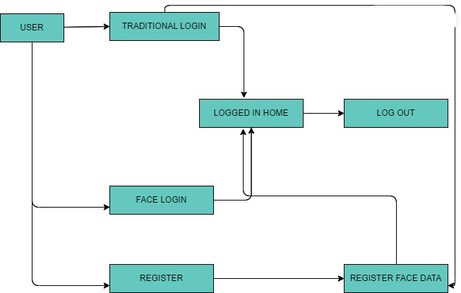
Flow Diagram

Slide 12
MODULES:
LOGIN PAGE
REGISTER PAGE
FACE REGISTERING PAGE
FACE LOGIN
LOGGED IN HOME

Slide 13
SYSTEM TESTING
The purpose of testing is to discover errors.
Testing is the process of trying to discover every conceivable fault or weakness in a work product.
It provides a way to check the functionality of components, sub assemblies, assemblies and/or a finished product.
TYPES
Unit testing
Integration testing
Functional test

Slide 14
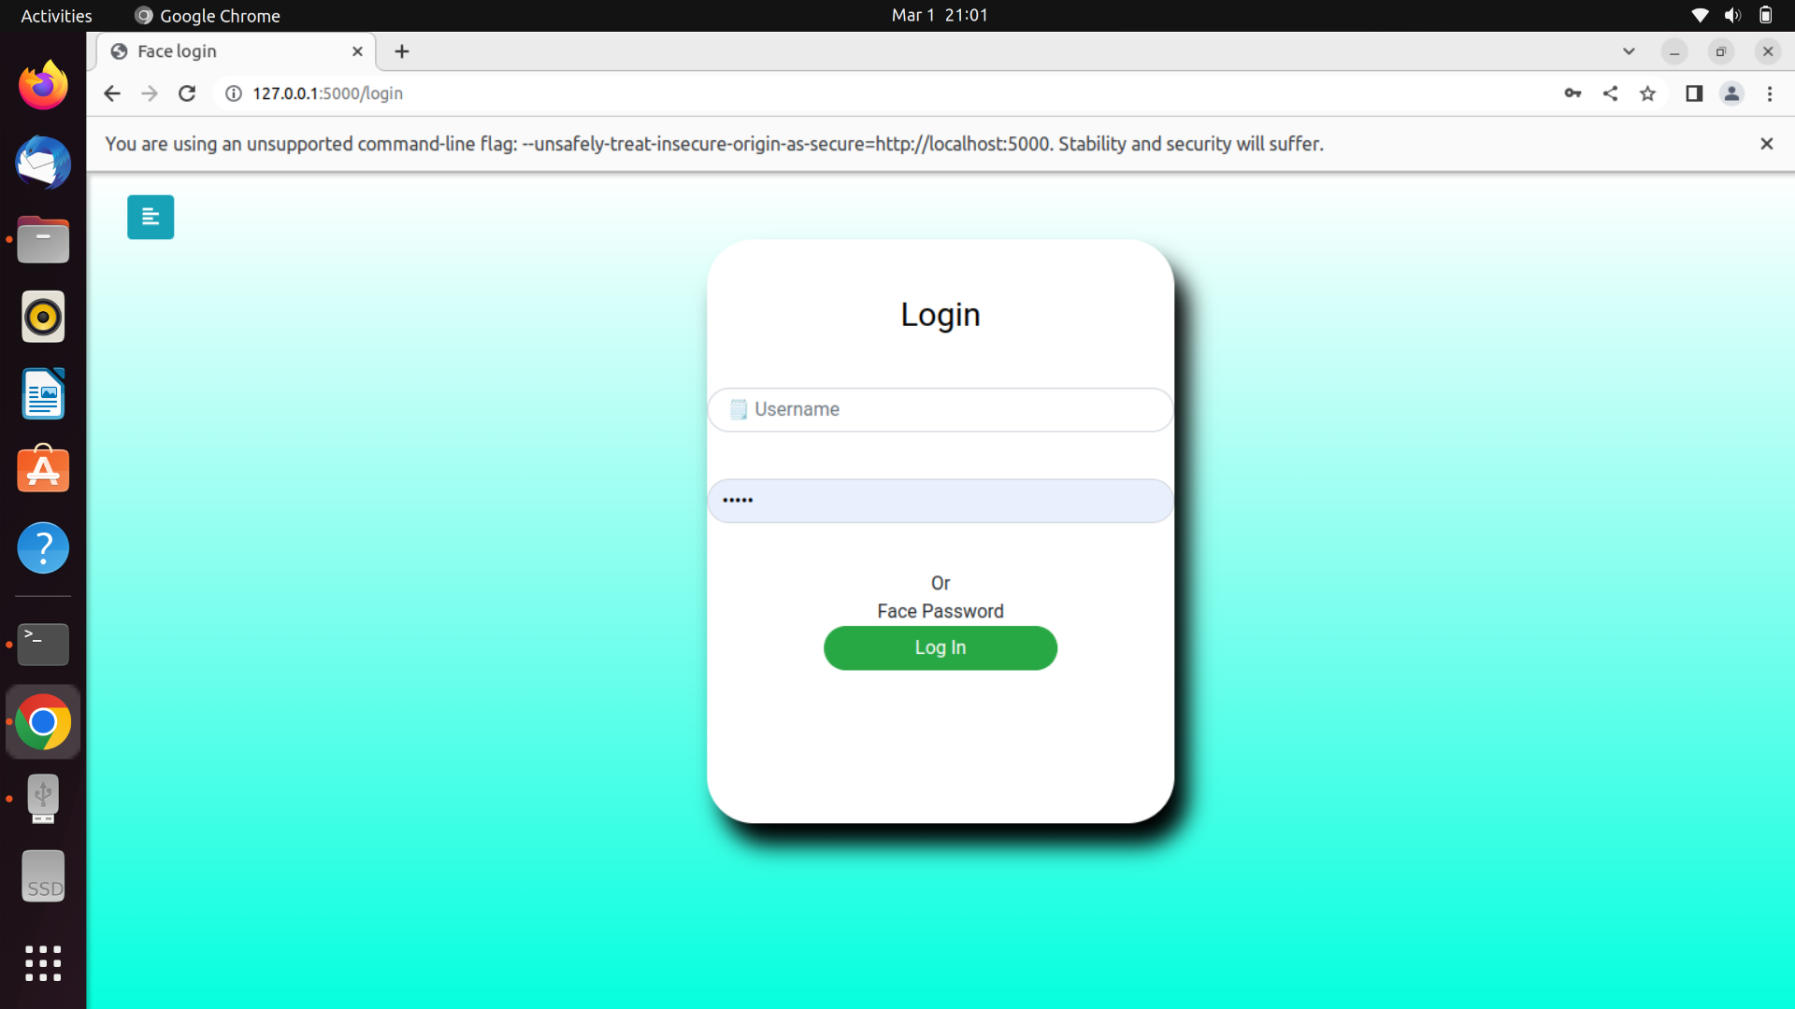
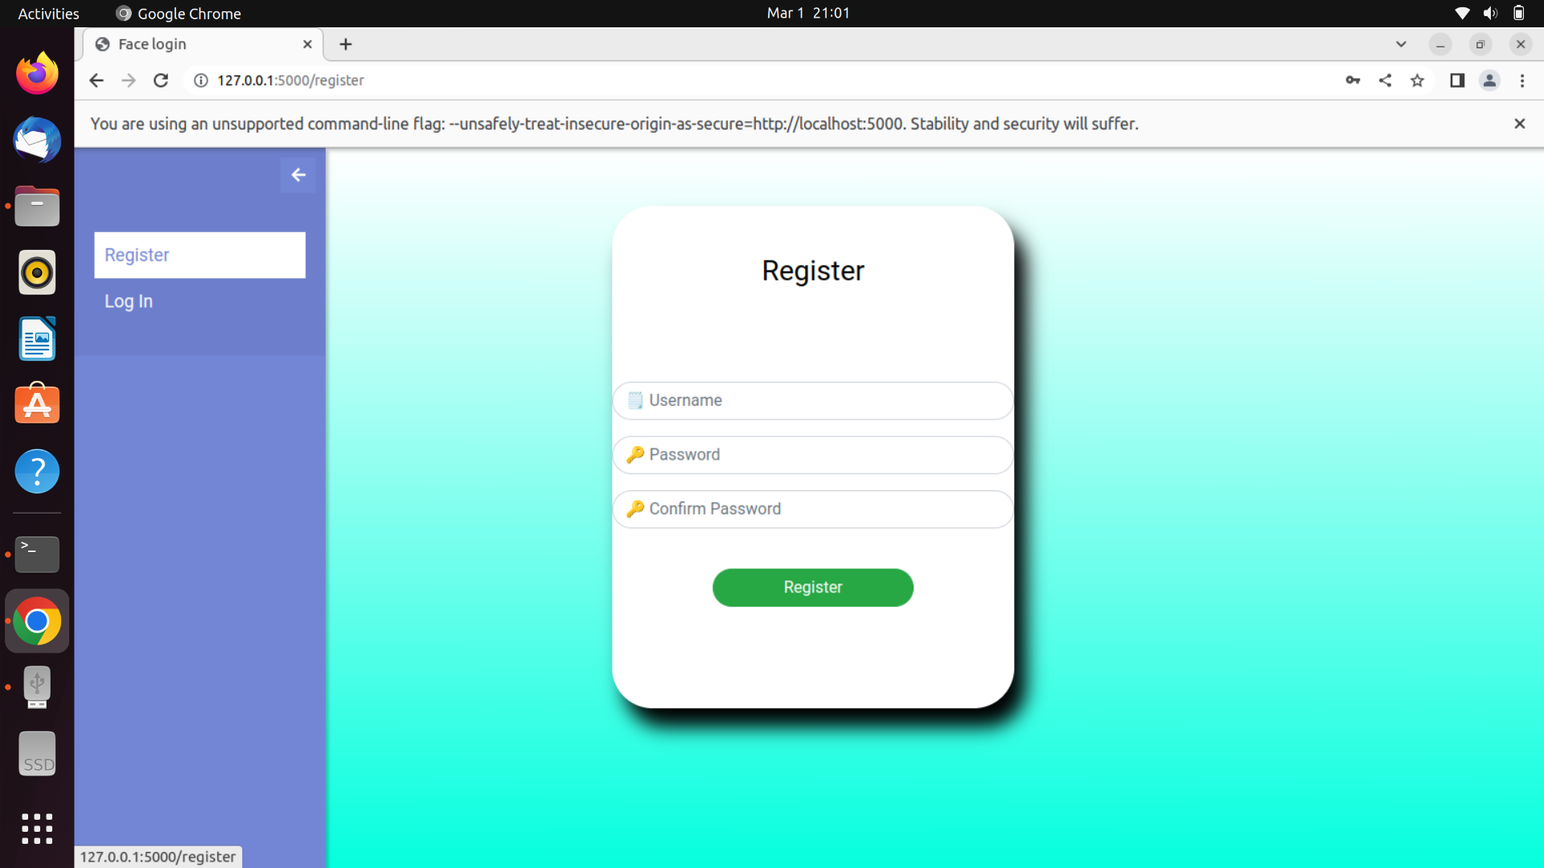
SCREENSHOT

Slide 15
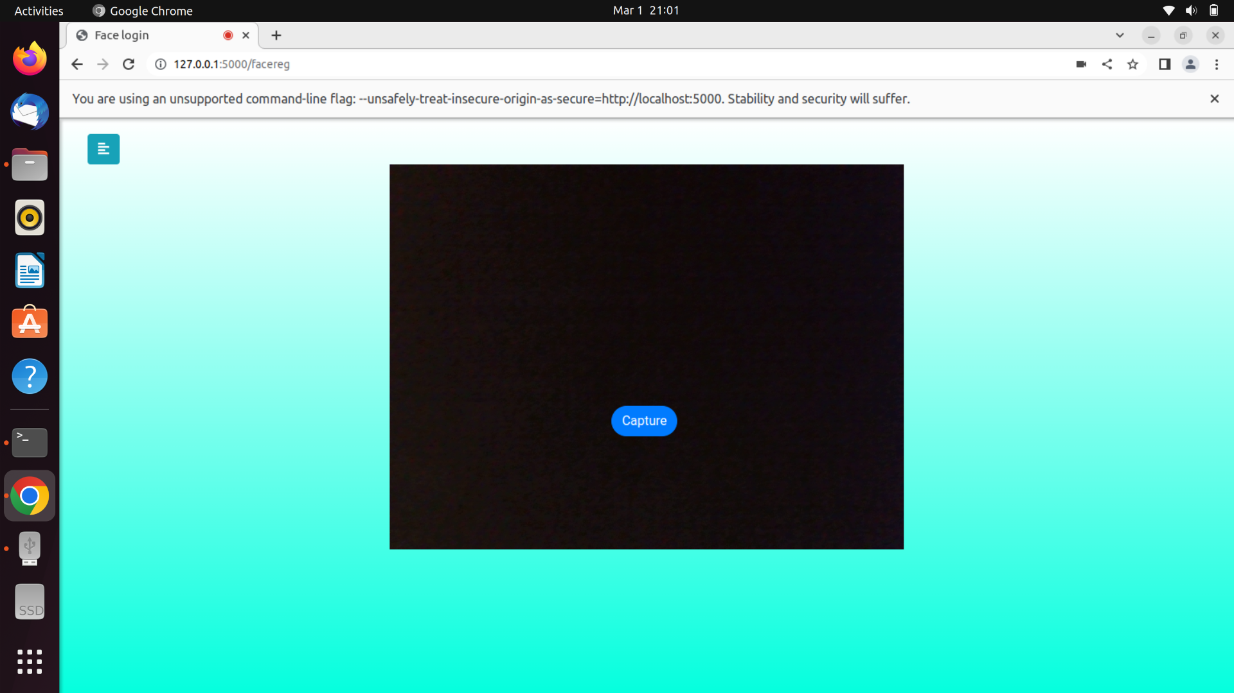
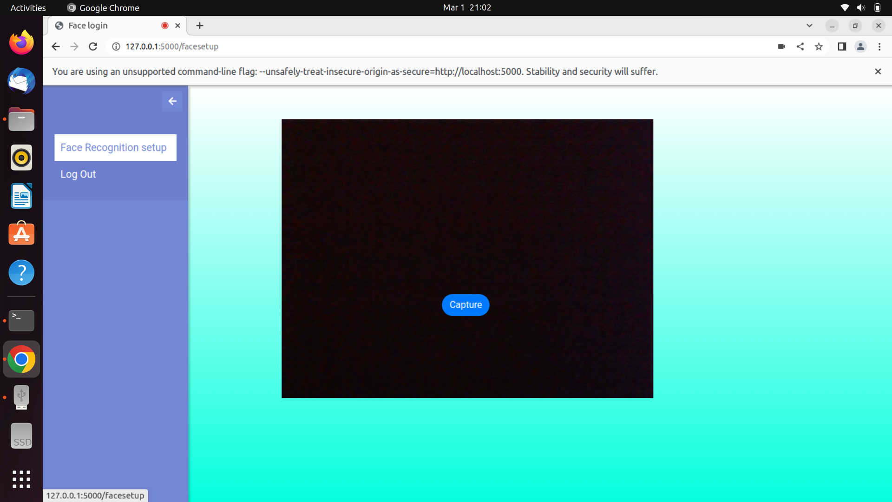
SCREENSHOT

Slide 16
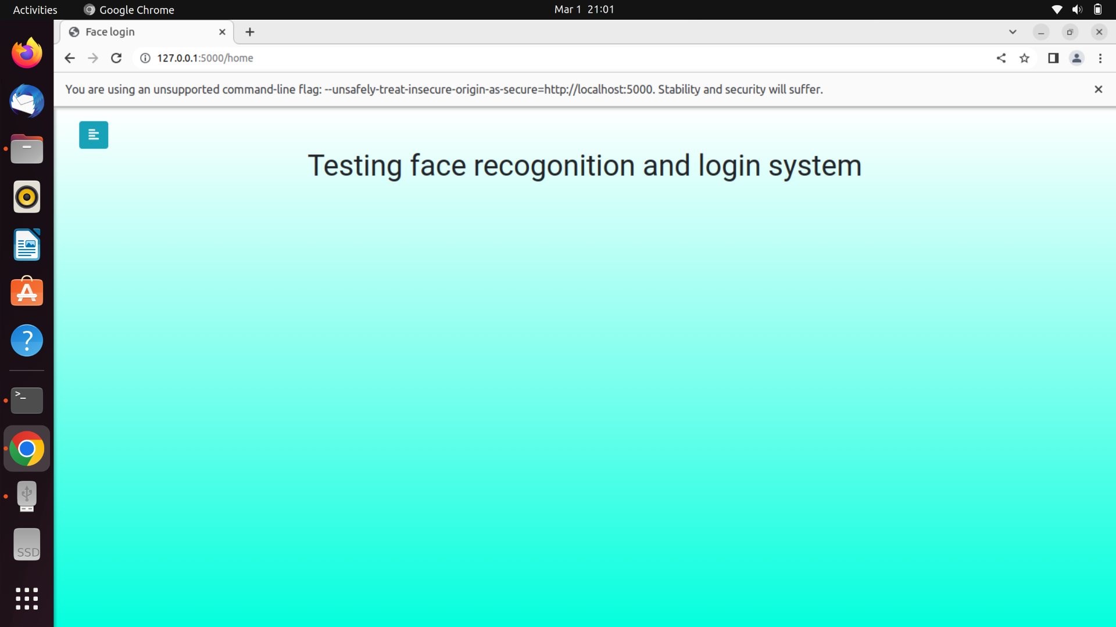
SCREENSHOT

Slide 17
CONCLUSION
We have done our project as open source everyone can use it to recreate this application.
It can be used second auth method for every site

Slide 18
FUTURE ENHANCEMENTS
In future this system can be included in every website that we use everyday as a security mechanism.
Increase the accuracy of the system.
Include live detection processing at user side.

Slide 19
THANK YOU !

